Slide 1
Team 17
Sprint 3 Presentation

Slide 2
Presentation outline
Presentation will be around 15 minutes
15 minutes at the end for questions
Please feel free to stop me at anytime for clarification or other questions
Let me know if anything is hard to see over the screen share, we can always open up the relevant document to zoom in

Slide 3
Topics we will be covering
Current project backlog
Sprint 3 Summary + retrospective overview
Risk management plan
UI Prototype showcase
Architecture review + tech stack
Testing plan
Live demo
Sprint 4 planning
Questions?

Slide 4
Project Outline

Slide 5

Our Application

Slide 6
Current project backlog

Slide 7
Current project epics
Patient Management
Status Management
Contact Tracing
Appointments
Messaging System
Notification System
QR Code System
Authentication and Authorization
Project Setup
Project Infrastructure
Documentation
**View individual user stories from the backlog in the document submitted**

Slide 8
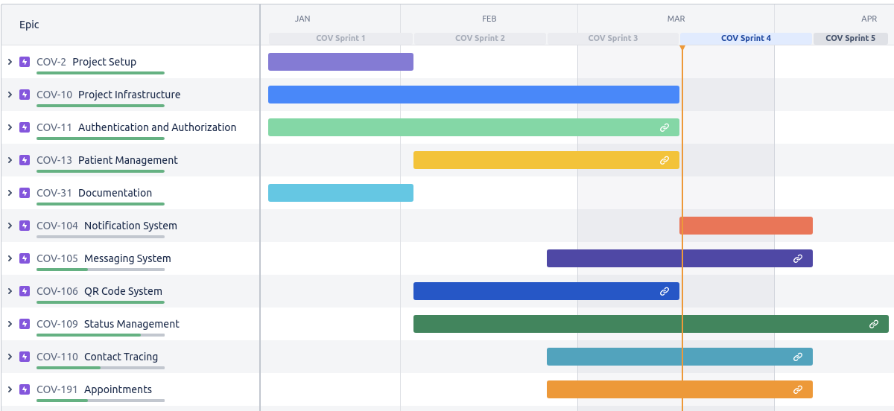
Progress in project

Slide 9
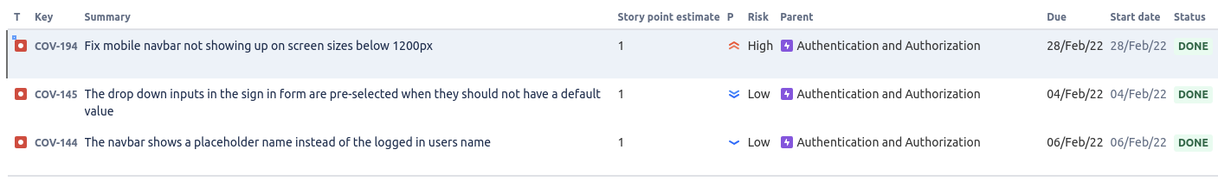
Defect tracking report
Total number of bugs: 3
Number of resolved bugs: 3

Slide 10
Sprint 3 Summary + retrospective overview

Slide 11
Our focus for sprint 3
Build out the dashboards and data tables so our users can see the data in the system
COVID tests
Status reports
Patient management
Expand out the UI mockups for sprint 4 and refine user stories for sprint 4
Committed to 70 USP
Completed of 76 points and closed all issues in the sprint

Slide 12
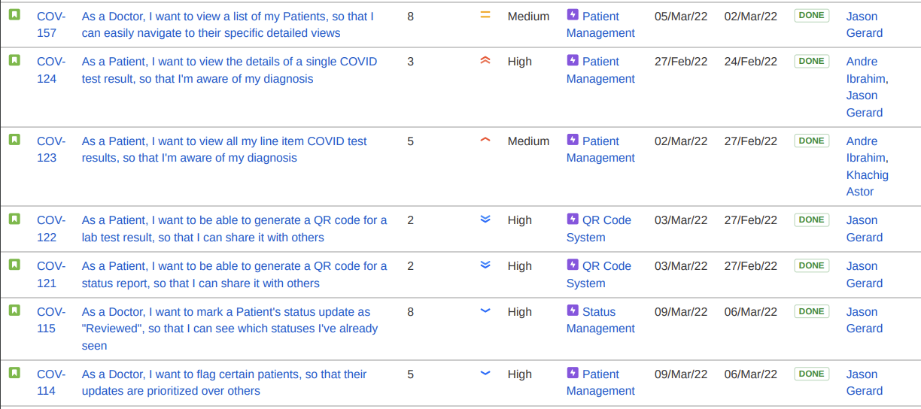
User stories completed

Slide 13
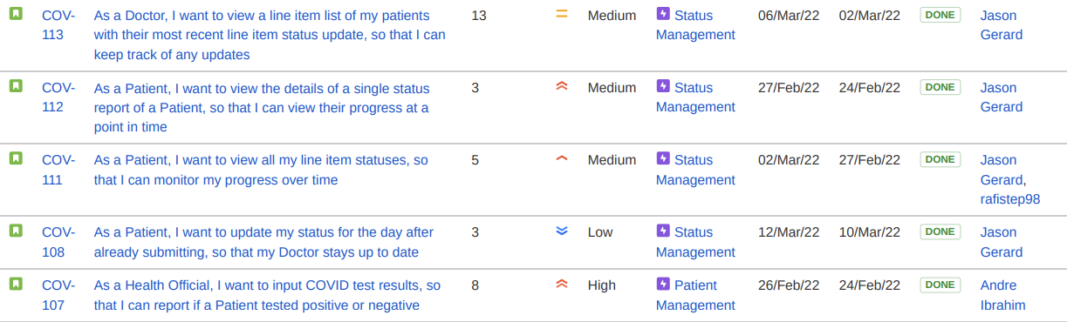
User stories completed cont.

Slide 14
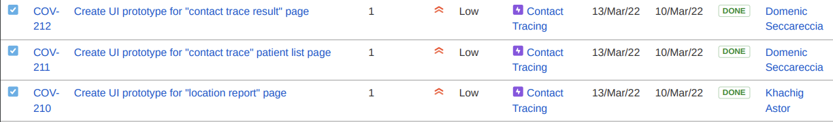
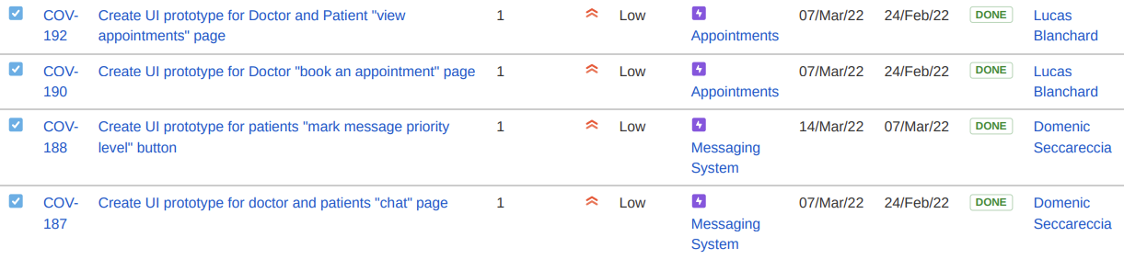
Tasks for UI mockups and prototypes

Slide 15
Tasks for Project Infrastructure

Slide 16
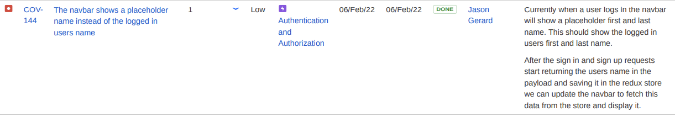
Bug / defect fixes

Slide 17
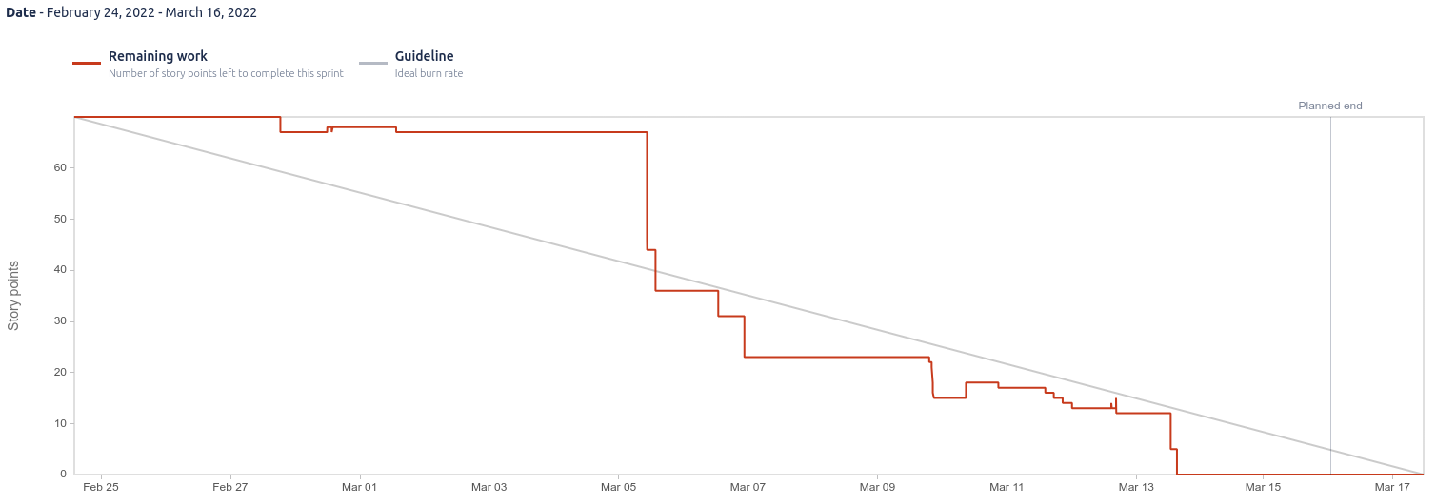
Burndown chart

Slide 18
Project velocity after sprint 3
Sprint 1 -> 56 USP
Sprint 2 -> 73 USP
Sprint 3 -> 76 USP
Velocity = 68.33 USP

Slide 19
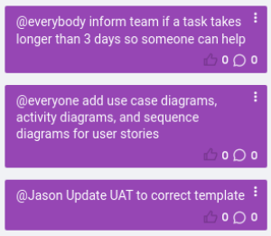
Our actions item(s)

Slide 20
Risk management plan

Slide 21
Identified risks
We have identified 12 different risks for our project, all are documented in the submission.

Slide 22
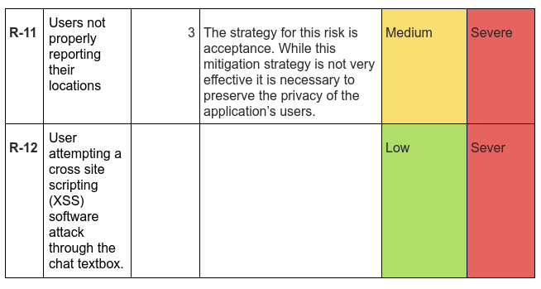
Risk(s) identified in sprint 3

Slide 23
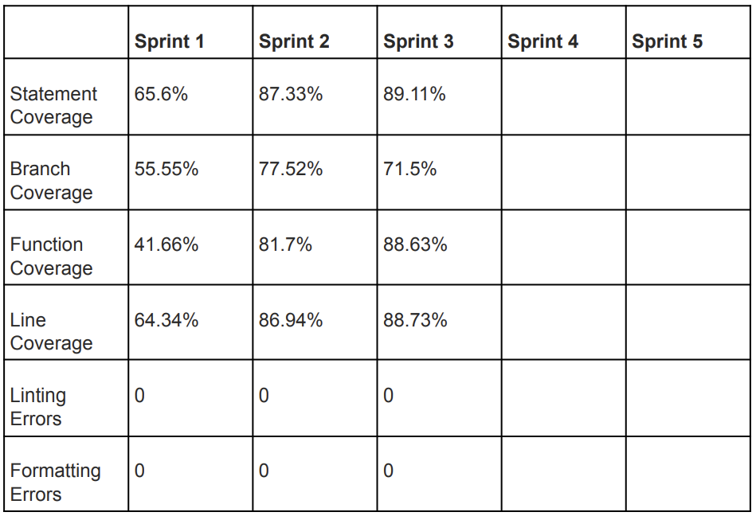
Update on quality metrics

Slide 24
UI Prototype showcase

Slide 25
Let's go into Figma and see the UI mockups and interactive prototypes

Slide 26
Architecture review + tech stack

Slide 27
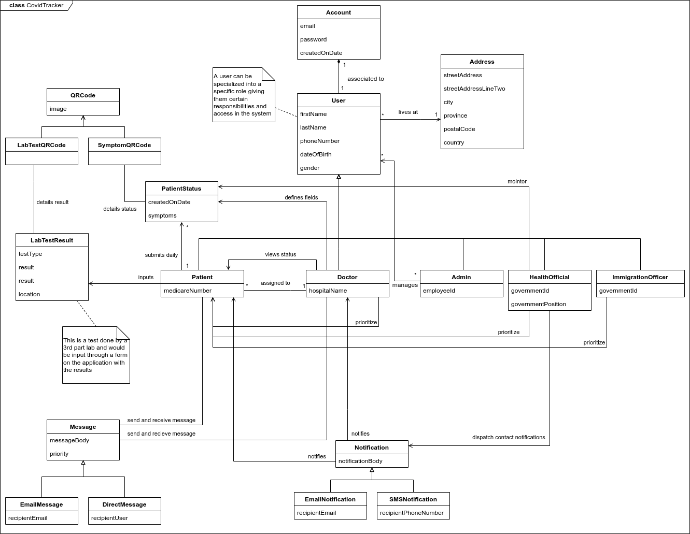

Slide 28
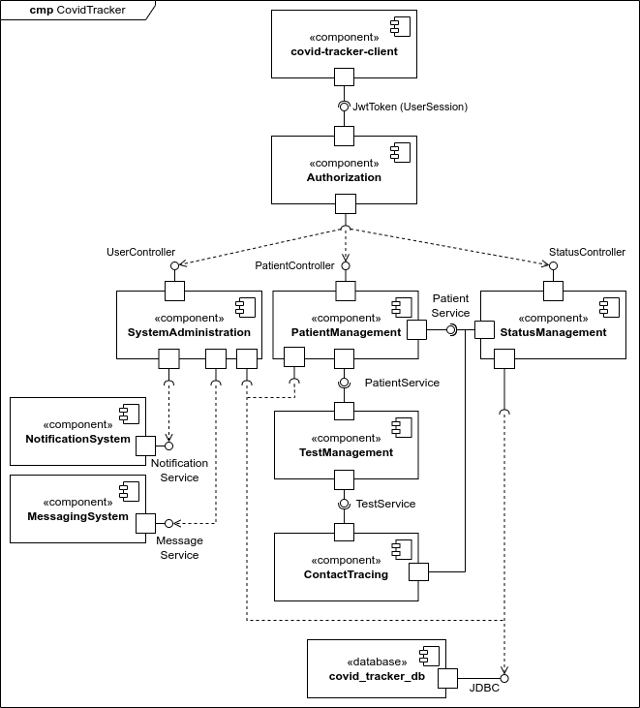

Slide 29
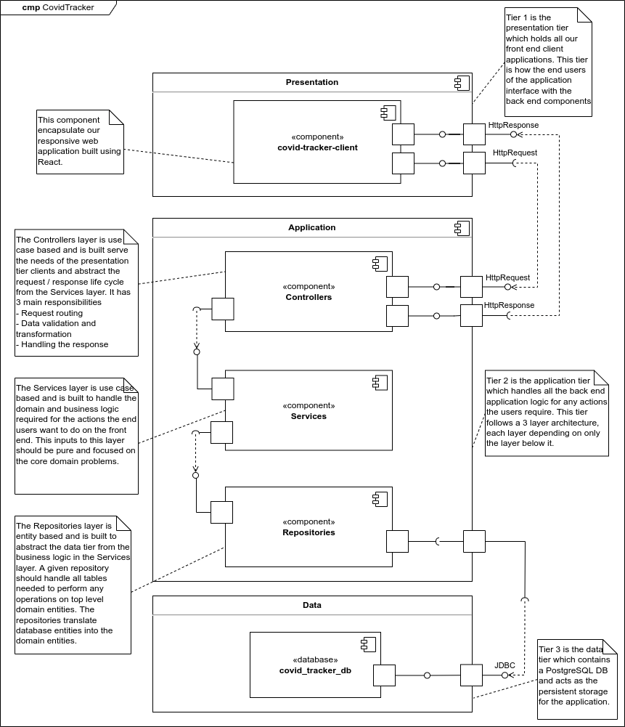

Slide 30
Use Case Diagrams
1 diagram per user type / persona

Slide 31
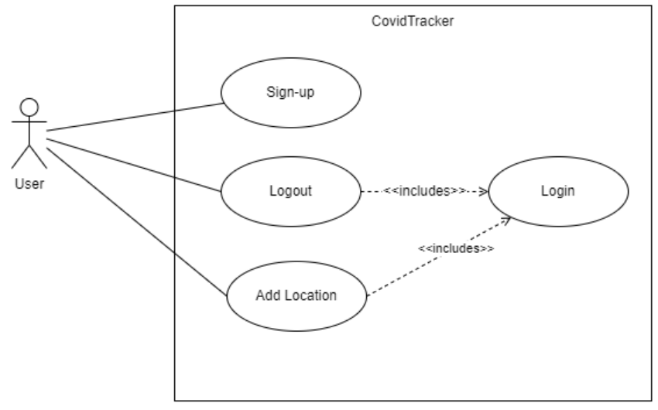

Slide 32
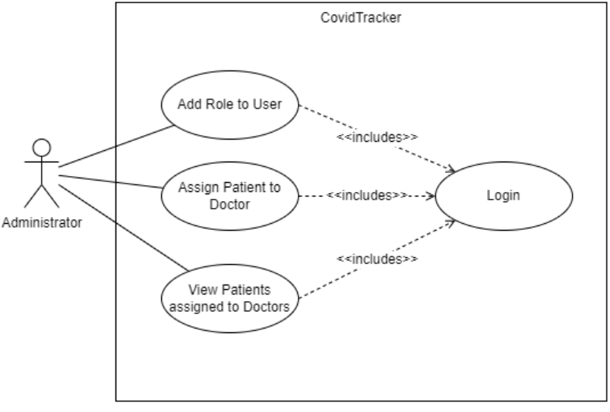

Slide 33
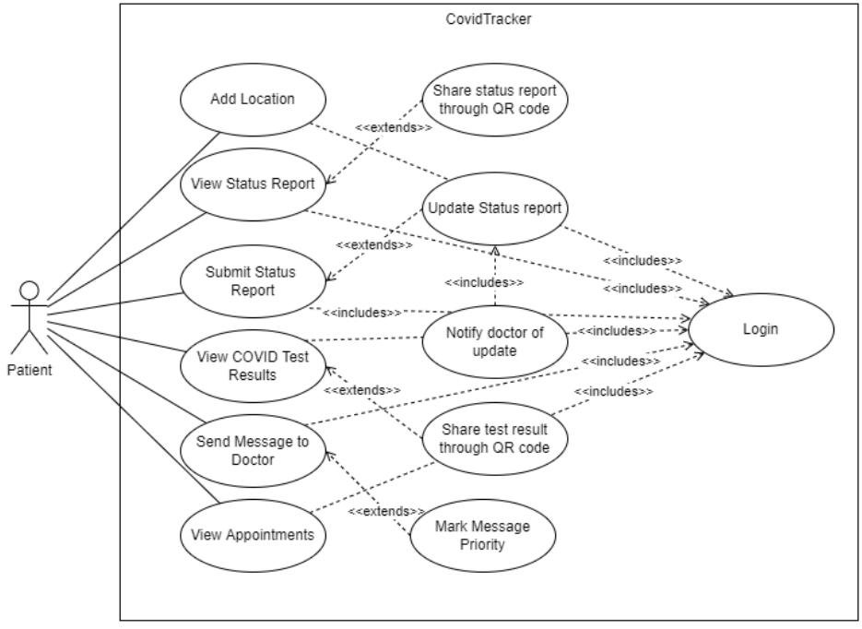

Slide 34
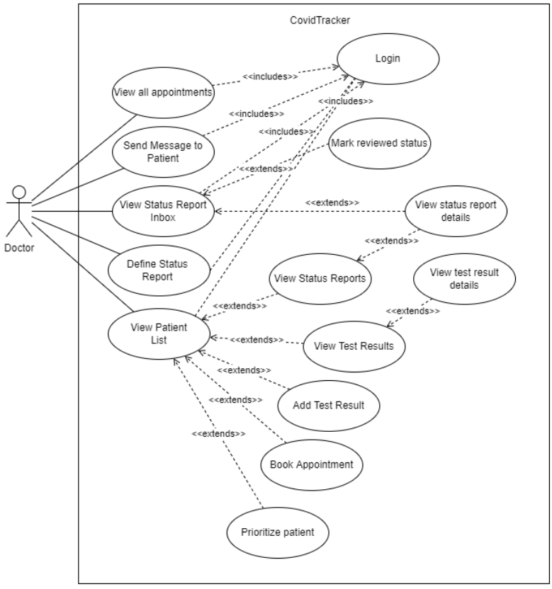

Slide 35
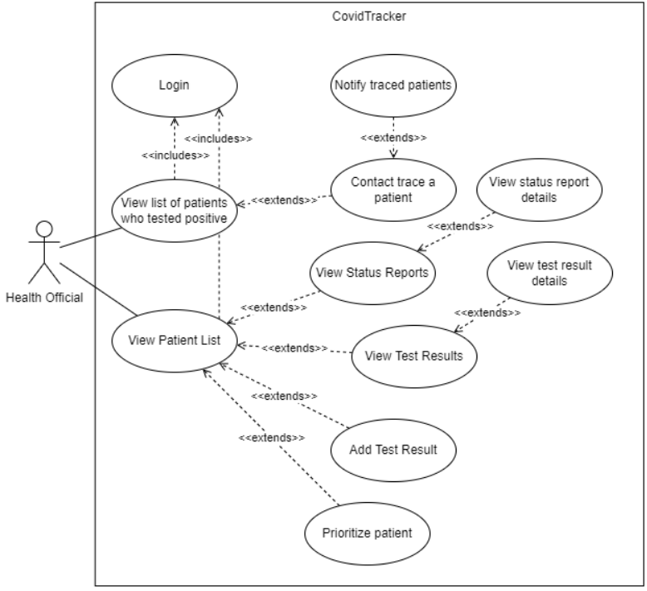

Slide 36
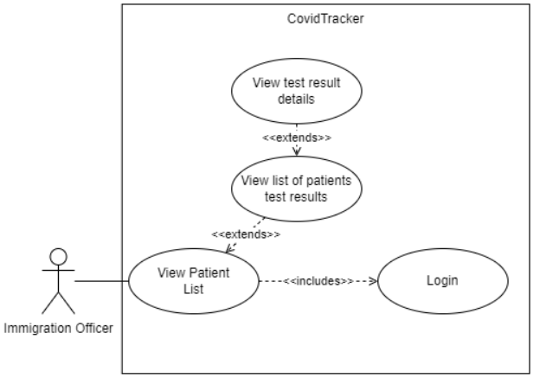

Slide 37
Viewpoint - Status report management
Covers the flows and business rules of status report management
Personas involved
Patient
Doctor
Health Official
3 flows identified
Defining status report fields for a patient
Patient submitting a status report
Viewing a status report

Slide 38
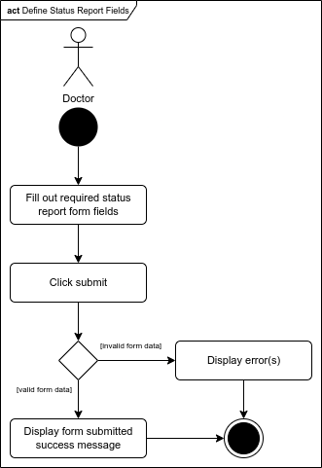

Slide 39
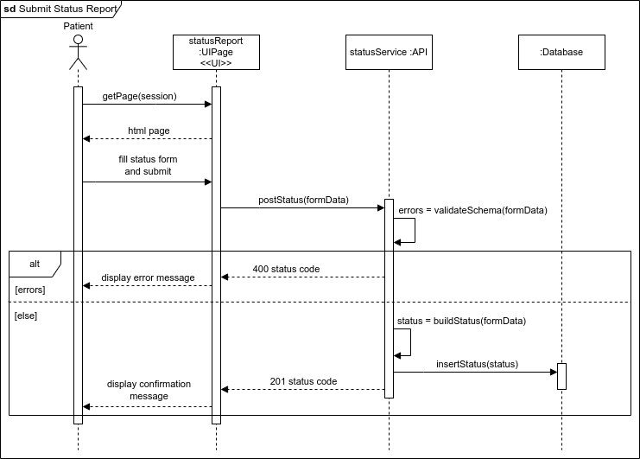

Slide 40
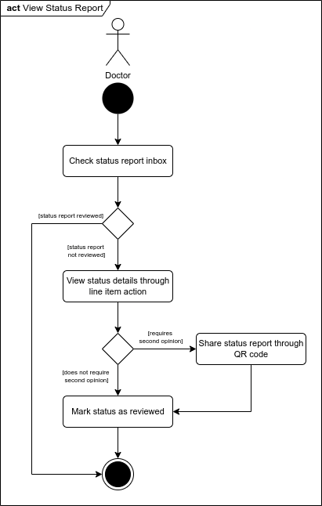

Slide 41
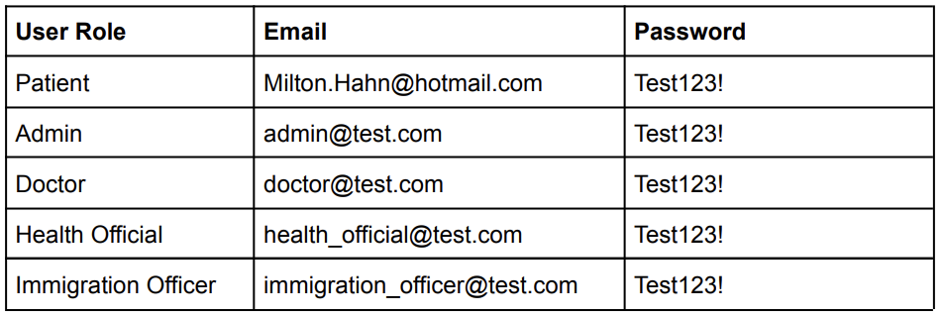
Deployment
Deployed on S3 + ECS
http://covid-tracker-client-bucket.s3-website.us-east-2.amazonaws.com/

Slide 42
Testing plan

Slide 43
Our testing plan
We have identified 4 types of tests for our system
Unit tests
Integration tests
System tests
Acceptance tests
Most are automated some are manual
Some have output reports
**More about the specific packages we use for our testing framework and a comparison between all of them can be found in the document**

Slide 44
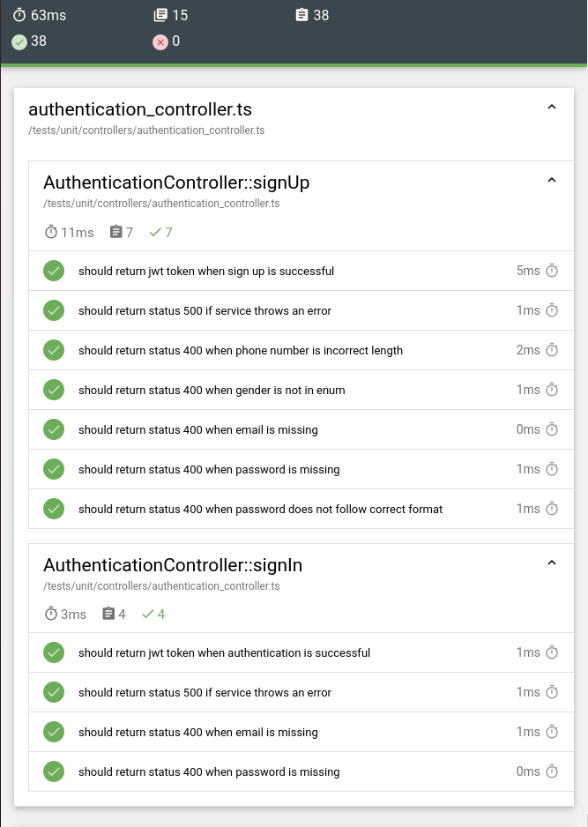
Unit test report
49 unit tests
39 integration tests
15 test suites
0 failures

Slide 45
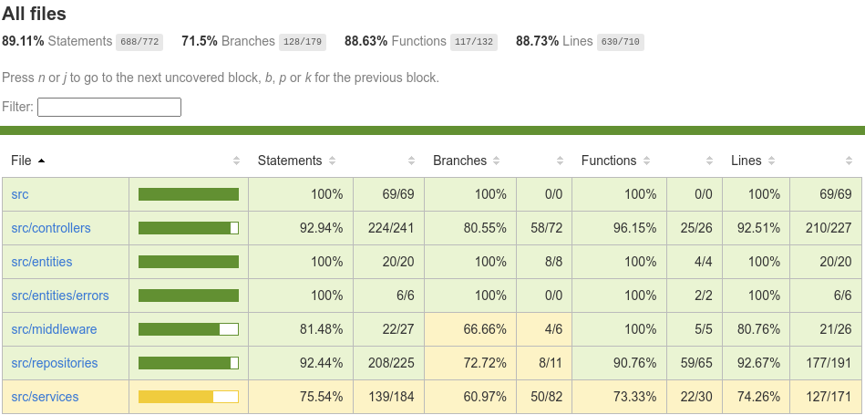
Code coverage report

Slide 46
Integration tests
Our integration tests are automated tests
The tests use a full PostgreSQL DB instance running in docker
We have written db initialization and seeding scripts to help scaffold the tests

Slide 47
System Tests
Updated system test templates
Viewable in the submission document
Run manually
Can be automated but not on our roadmap
Tests the systems functionalities end-to-end
Format is steps / action for the tester to perform and the associated outcome for each
System tests for each user story can be found in the submission document

Slide 48
Acceptance Tests
Updated acceptance test templates
Viewable in the submission document
Run manually
Can be automated but not on our roadmap
Tests the system according to the requirements
For use this means they are derived directly from our user stories
Format is Gherkin Syntax which is a behavioral driven development (BDD) syntax that allows us to define our tests in terms of user state and behavior
Acceptance tests for each user story can be found in the submission document

Slide 49
Live demo

Slide 50
Sprint 4 planning

Slide 51
What’s next in sprint 4?
Our focus will be on delivering
Contact Tracing
Patient Appointment
Notification System
Messaging System
Sprint 4 contains 67 story points

Slide 52
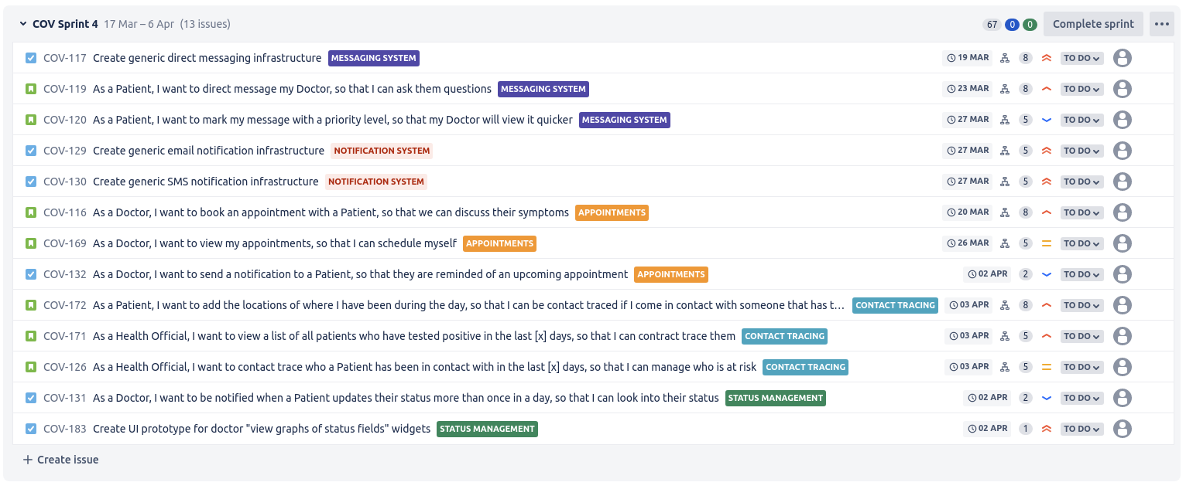

Slide 53
Questions?

